Slide 1
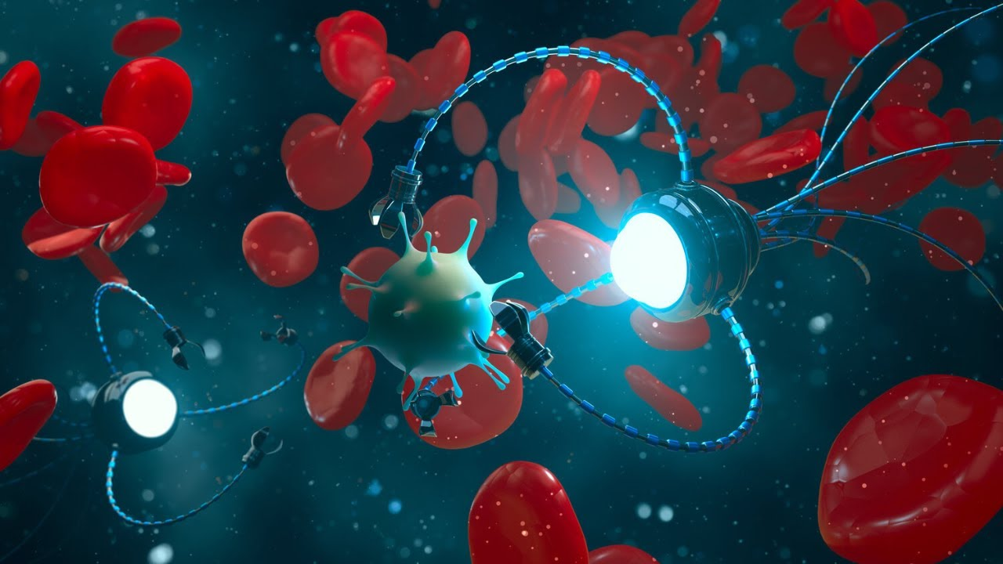
Nanorobots
By IU5-42B Students
Kudabaeva Evita

Slide 2
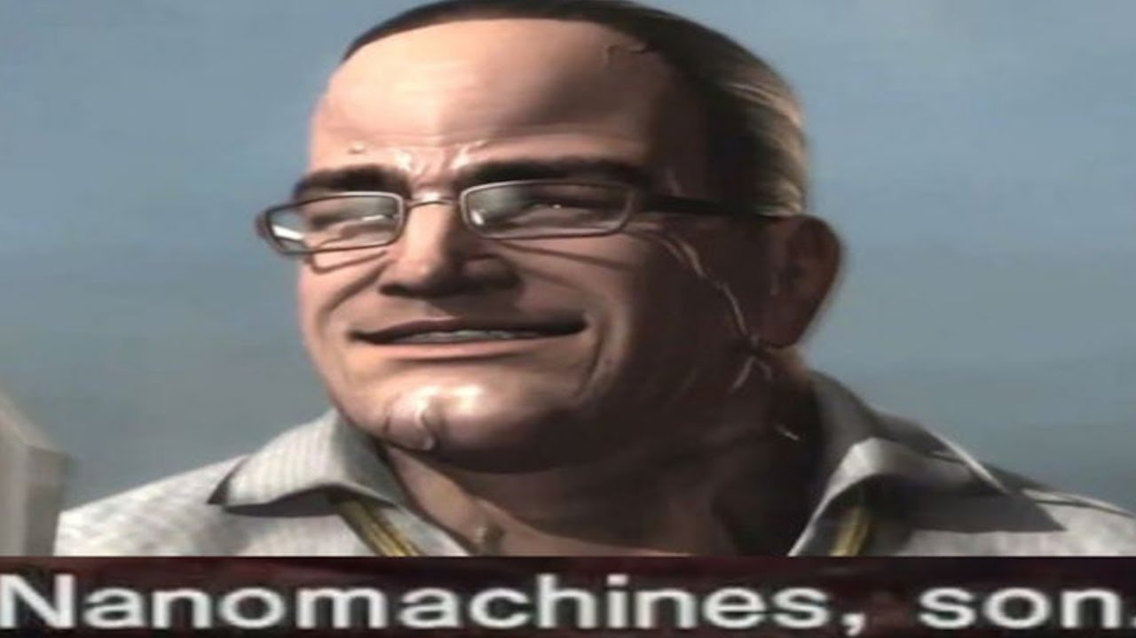
Contents of the presentation
Definition of Nanorobots
Concept and Design
Working Mechanism
History: From Early Steps to Nowadays
Expert Opinions and Ethical Considerations
Future Development and Predictions
Conclusion
Sources

Slide 3
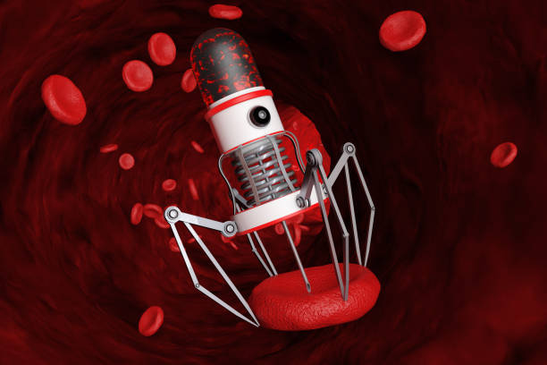
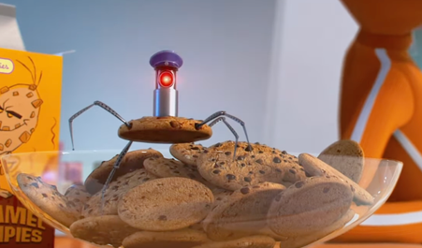
Defining Space Robotics
Nanorobots (nanobots) are microscopic machines designed to perform specific tasks at the nanoscale (1–100 nanometers).
They can be programmed to carry out medical, industrial, or environmental functions.
Key features:
1) precision,
2) autonomous/semi-autonomous operation,
3) ability to interact at a cellular or molecular level.
Nanorobot
Cookie robot from “Despicable me”, lol, wth is this doing here

Slide 4
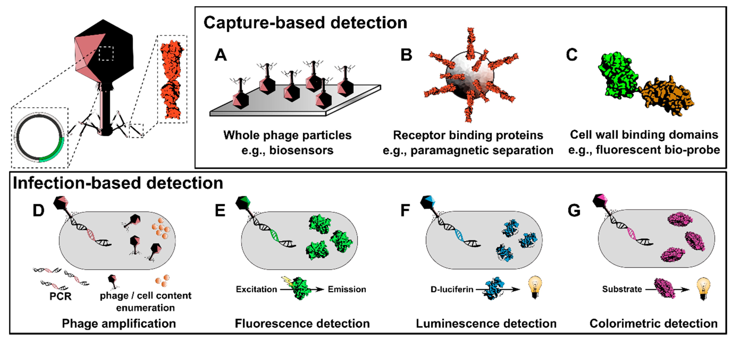
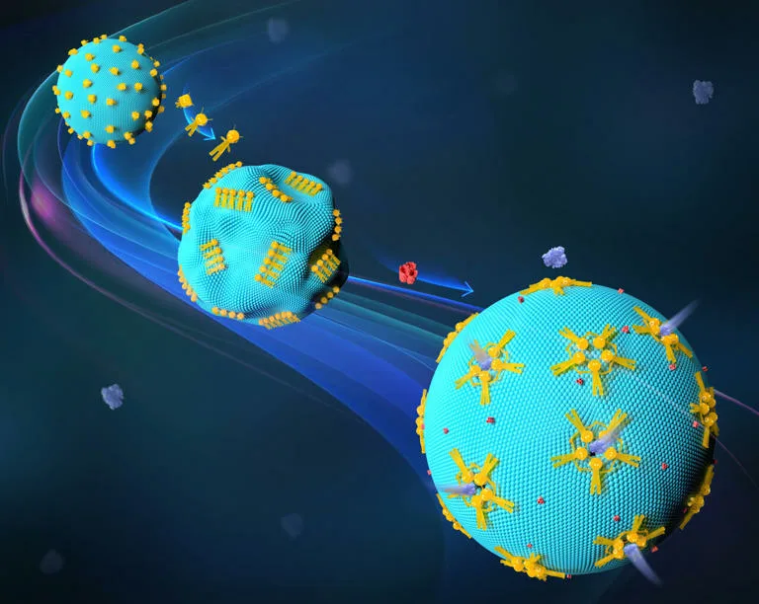
Concept and design:
Biological nanorobots:
Made from DNA, proteins, or organic materials (e.g., DNA origami robots).
Synthetic nanorobots:
Built using nanomaterials like carbon nanotubes, graphene, or metals.
Hybrid designs:
Combine biological and synthetic components.
Examples:
DNA nanobots for targeted drug delivery (Nature, 2018).
Bacterial nanorobots for tumor detection (Science Robotics, 2020).
Tumor and infection detection concepts
DNA nanobots for targeted drug delivery (Nature, 2018).

Slide 5
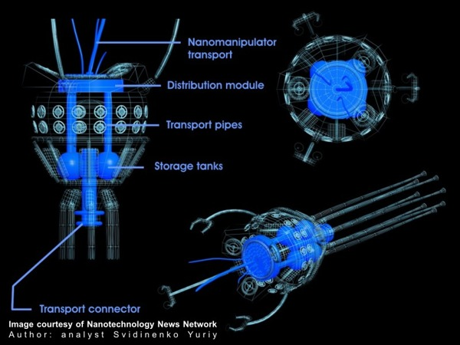
Structure and Working Mechanisms
Nanorobots operate through:
Sensing: Detect chemical signals (e.g., pH, temperature, biomarkers).
Processing: Use onboard nano-computing for decision-making.
Actuation: Move using:
Chemical propulsion (enzyme reactions).
Magnetic guidance (external magnetic fields).
Biological motors (flagella-based movement).
Medical Applications:
Targeted drug delivery (e.g., cancer treatment).
Surgery at cellular level (e.g., plaque removal in arteries).
1
2
3
4
5
6

Slide 6
History: From Early Steps to Nowadays
Year Milestone
1959 Richard Feynman introduces the concept of nanomachines in "There’s
Plenty of Room at the Bottom.“
1986 K. Eric Drexler publishes "Engines of Creation," popularizing
nanorobotics.
First DNA-based nanorobots developed by Nadrian Seeman.
First nanomotor for medical use demonstrated.
Harvard researchers create nanobots that can kill cancer cells.
2022 Nanorobots used in preclinical trials for blood clot removal.

Slide 7
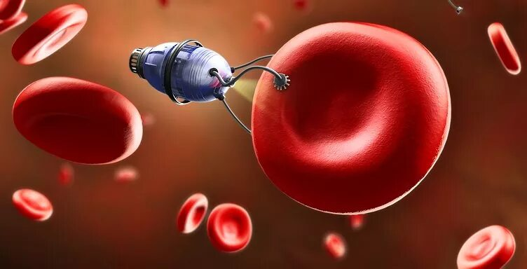
Opinions and Ethical Considerations
Pros:
✔ Precision medicine
(reduced side effects).
✔ Non-invasive surgeries.
✔ Environmental cleanup
(e.g., removing microplastics).
Cons & Ethical Issues:
❌ Potential misuse
(e.g., surveillance, bioweapons).
❌ Long-term safety concerns (toxicity, immune response).
❌ Regulation challenges (global oversight needed).

Slide 8
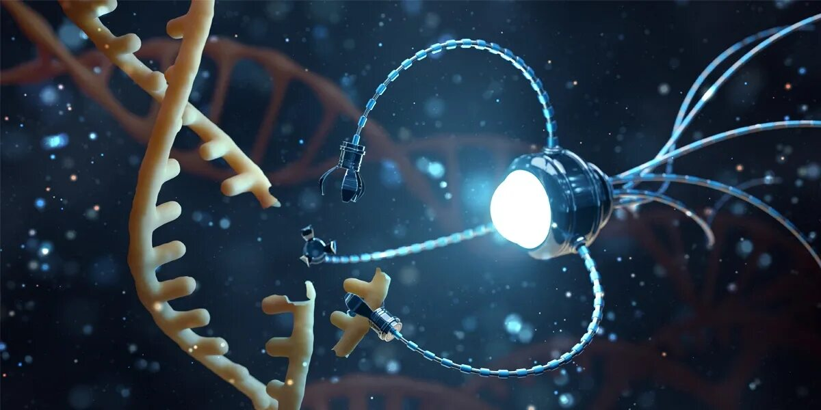
Future Development and Predictions
By 2030:
FDA-approved nanorobots for cancer therapy.
Self-replicating nanobots for industrial use.
By 2050:
"Nanorobot swarms" for repairing organs.
Integration with AI for real-time diagnostics.
Prediction:
"Nanorobots could revolutionize medicine, making today’s surgeries seem primitive." – Ray Kurzweil, Futurist

Slide 9
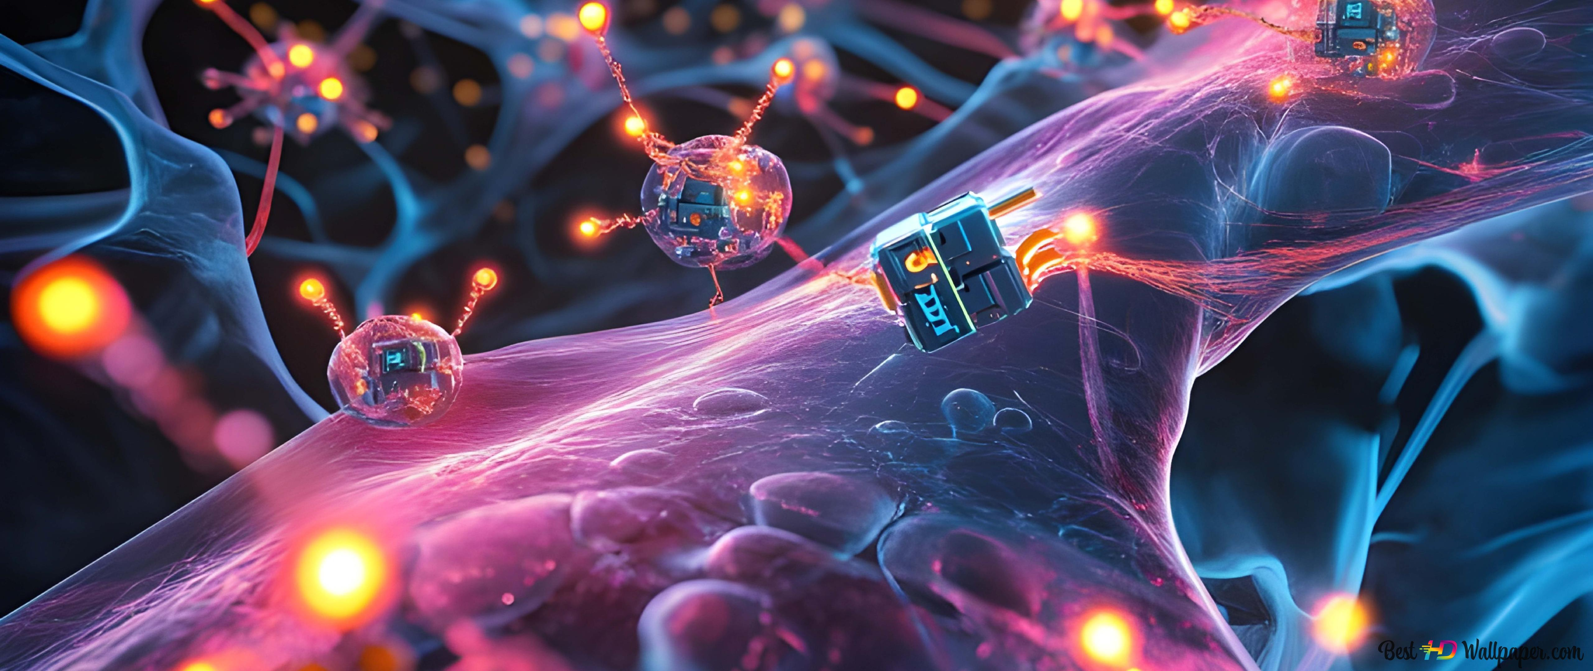
Conclusion
Nanorobots represent a breakthrough in medicine and technology.
Challenges remain in safety, ethics, and mass production.
The future holds immense potential for disease eradication and advanced manufacturing.

Slide 10

Thank you for your attention!

Slide 11
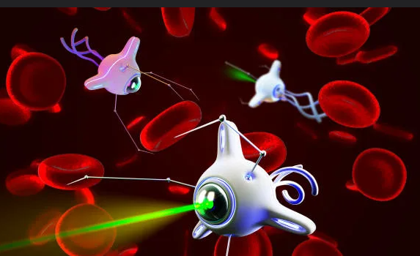
Sources:
Freitas, R. A. (2005). Nanotechnology, Nanomedicine and Nanorobotics. Springer.
Douglas, S. M., et al. (2012). "A logic-gated nanorobot for targeted transport of molecular payloads." Science.
Feynman, R. (1959). "There’s Plenty of Room at the Bottom." Caltech.
Wang, J. (2013). Nanomachines: Fundamentals and Applications. Wiley.
European Commission (2021). Ethics of Nanorobotics in Healthcare.
Kurzweil, R. (2005). The Singularity is Near. Viking Press.

